Slide 1
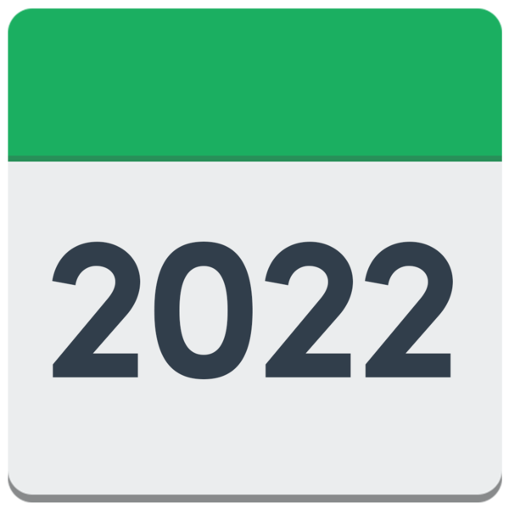
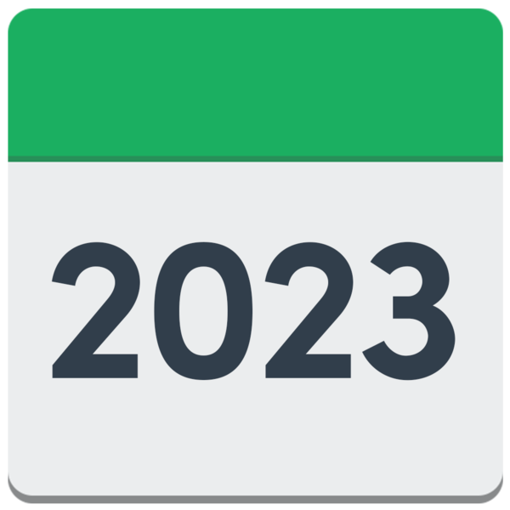
LeDeR Annual Report for Gloucestershire
2022 – 2023
LeDeR is learning about people’s lives and deaths so that we can make healthcare better for people with learning disabilities and autistic adults.

Slide 2
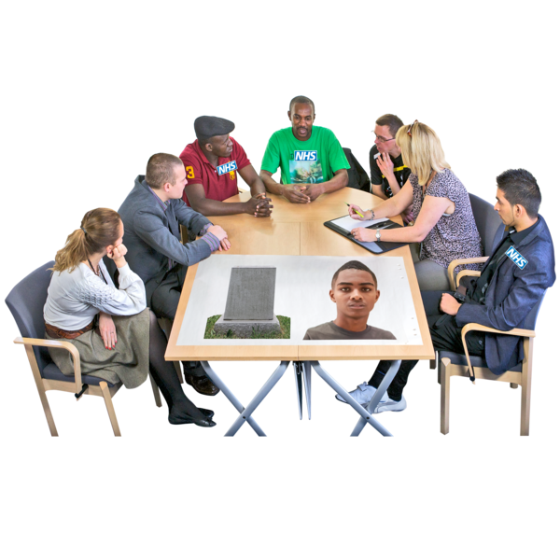
Opening Words
This is the fifth LeDeR annual report for Gloucestershire.
It looks at people with learning disabilities and autistic adults who died between 1st April 2022 – 31st March 2023.
The report shows what we have learnt from LeDeR reviews and how we have made healthcare services better.
Notes:
Trudi is the chair of the Gloucestershire LeDeR Steering Group and Deputy Director of Quality.
Marion is the Director of Quality and Nursing.

Slide 3
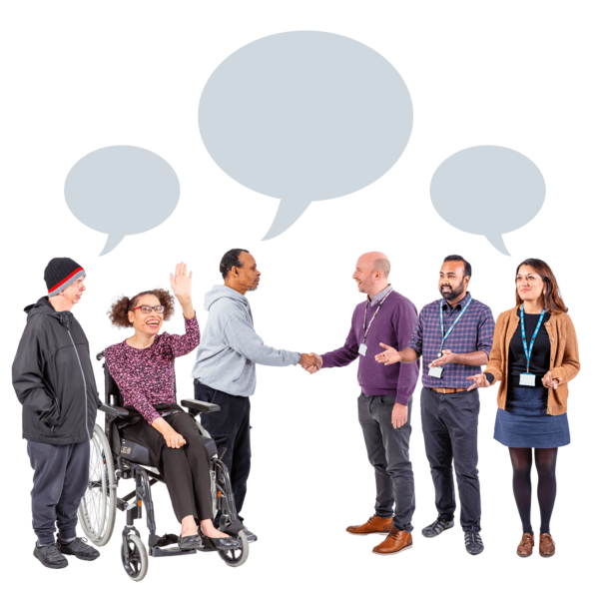
Opening Words
Inclusion Gloucestershire work with us.
Gloucestershire LeDeR is coproduced.
This means that Experts by Experience work with healthcare professionals.
Experts by Experience make sure the voice of people with learning disabilities and autistic adults is heard.

Slide 4
What our Experts by Experience said
Paul Tyrrell
Sammy Roberts
Nick Baker

Slide 5
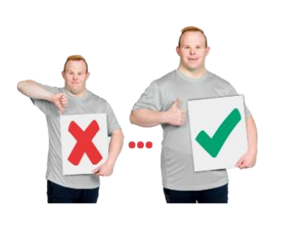
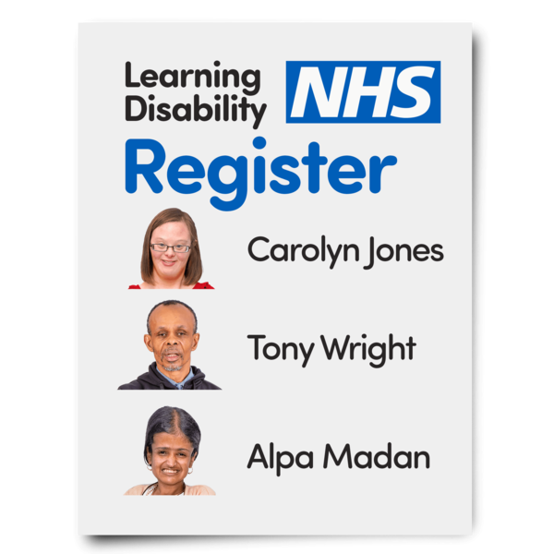
Background
LeDeR aims to reduce the unfair differences in healthcare that can be seen by people with learning disabilities and autistic adults.
LeDeR started in 2017 and it is now part of the NHS big plan for the future.
11,746 people in Gloucestershire have a learning disability.

Slide 6
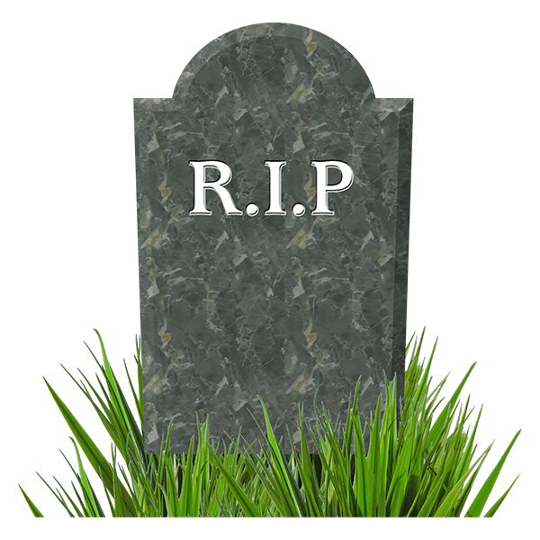
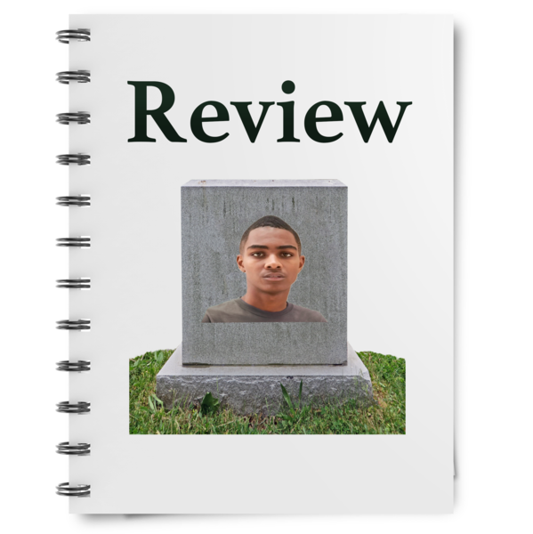
Background
People do not have to tell LeDeR about a death by law.
This means LeDeR is not told about everyone with a learning disability or an autistic person who has died.
Because of this we tell lots of people about LeDeR, so we are told about more deaths.

Slide 7
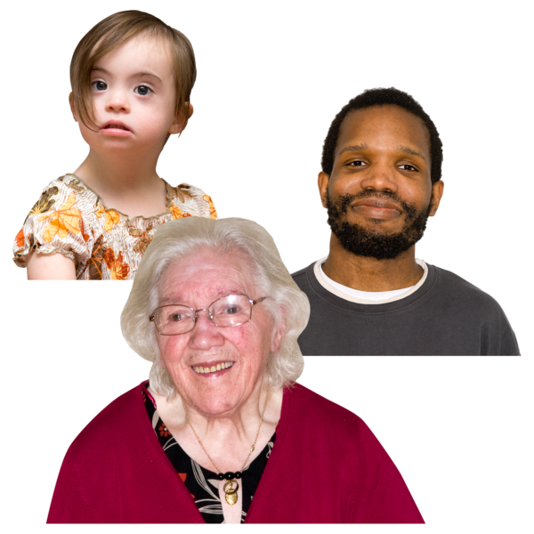
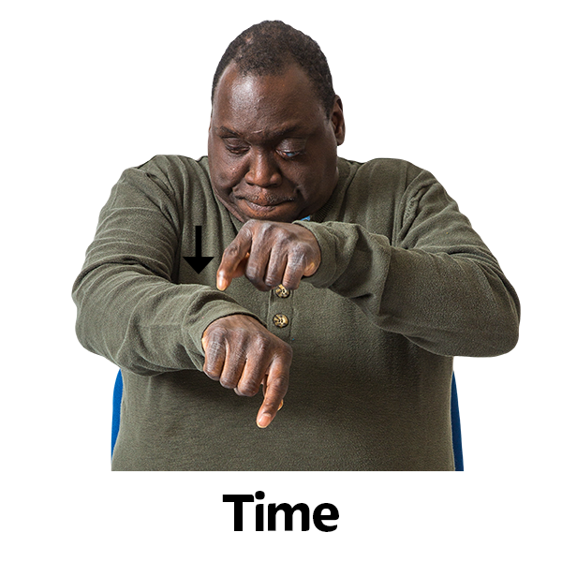
Things to remember
LeDeR only looks at people with a Learning Disability from aged 4 and autistic people over 18.
Delays in people telling us about a death makes it difficult to see patterns in the months of the year.

Slide 8
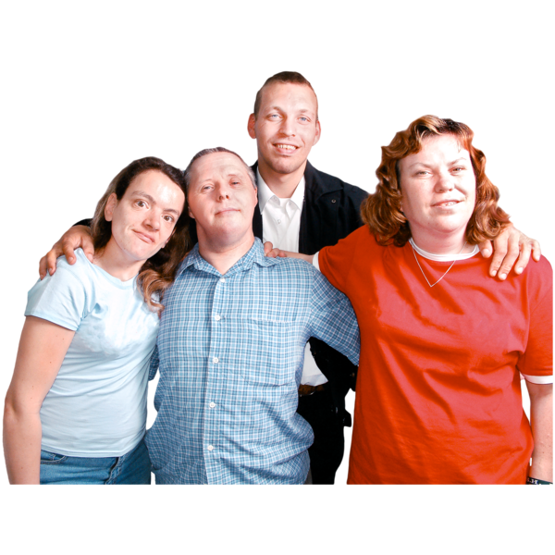
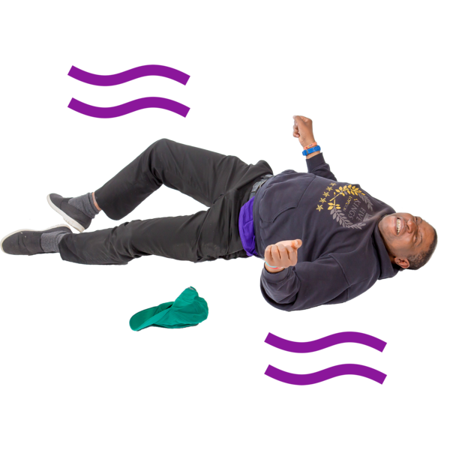
About people who died – Sandra
Sandra loved spending time with people and going out.
She had a mild learning disability, epilepsy and at times had mental ill health.
She had lived in the same place for 19 years, was happy and had very good care.
Sandra was given help to go to all medical appointments.

Slide 9
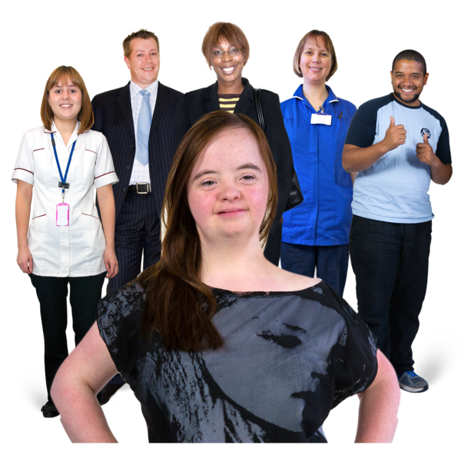
About people who died – Sandra
Sandra had a ReSPECT form.
She had help from lots of different healthcare workers, such as a Physio and Speech and Language Therapist.
Care staff found a lump on her leg.
After going to the doctors and having more tests it was found Sandra had cancer.

Slide 10
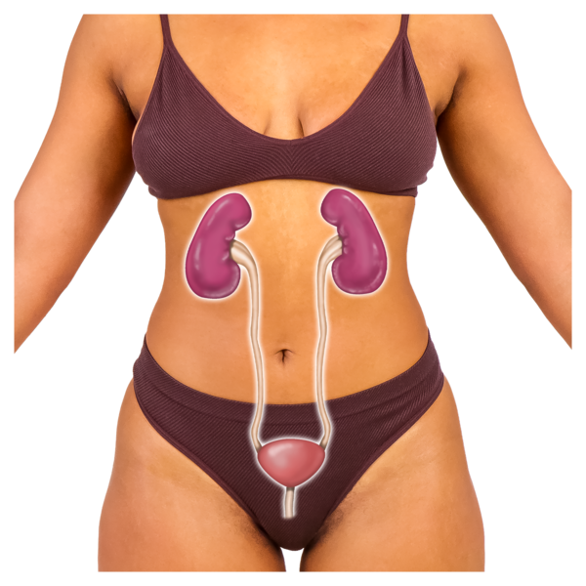
About people who died – Sandra
Sandra was too ill for cancer surgery
Her health got worse, and she had to go into hospital for chest and bladder infections.
A healthcare worker saw her at home, and it was found Sandra had COIVD-19
Sandra’s health carried on getting worse. Her family were told, and Sandra died at home. This is where she wanted to die.

Slide 11
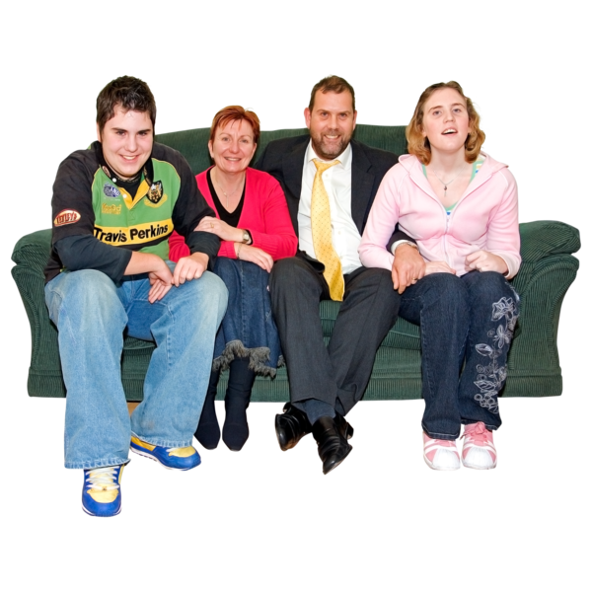
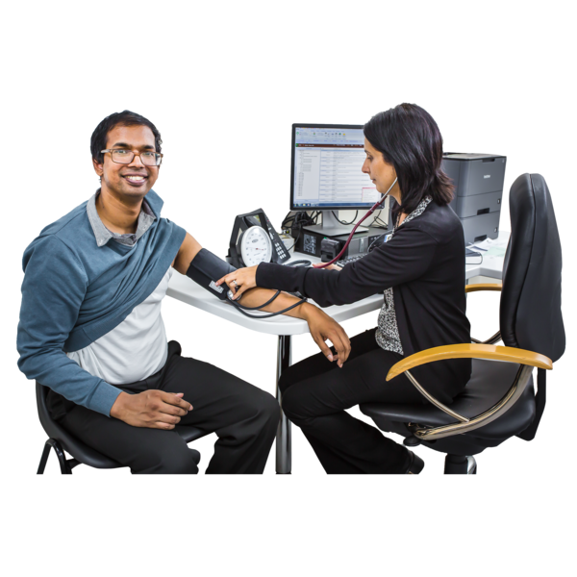
About people who died – Thomas
Thomas liked steam trains and visits to the countryside.
Family were very important to him.
Thomas had Cerebral Palsy and a mild Learning Disability.
He needed lots of help to live his life.
Thomas went to his Annual Health Checks and had a ReSPECT plan.

Slide 12
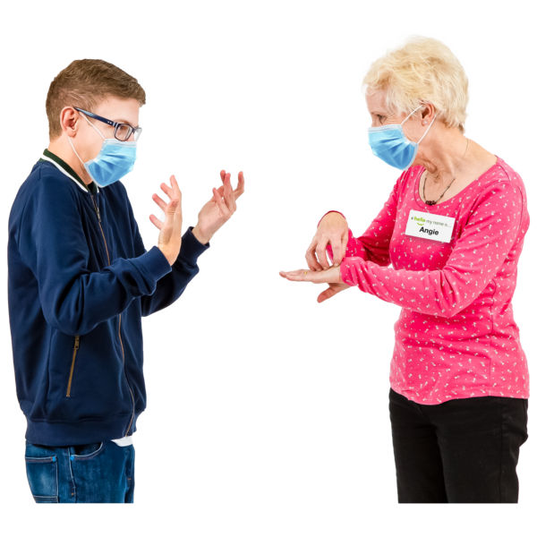
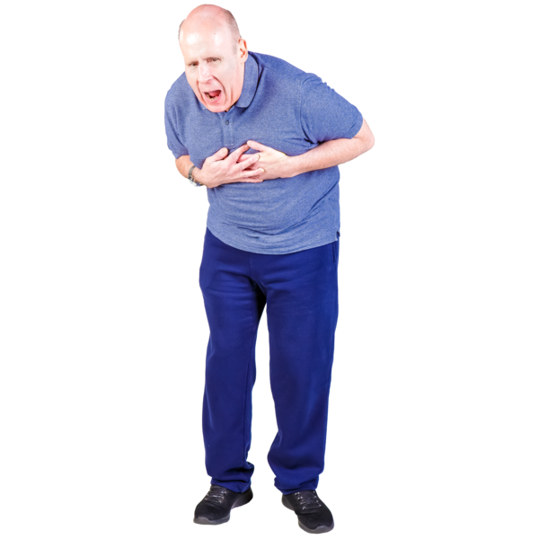
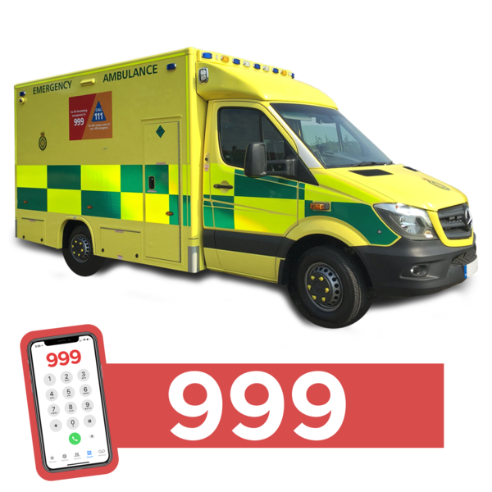
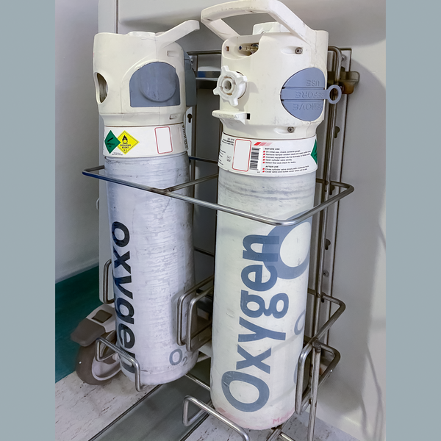
About people who died – Thomas
Thomas needed to see a Speech and Language Therapist, for difficulties with communication.
This was delayed as the Speech and Language therapist did not know he was getting lots of chest infections.
When visiting Thomas, a physio and speech and language therapist were worried about his oxygen levels so called an ambulance.

Slide 13
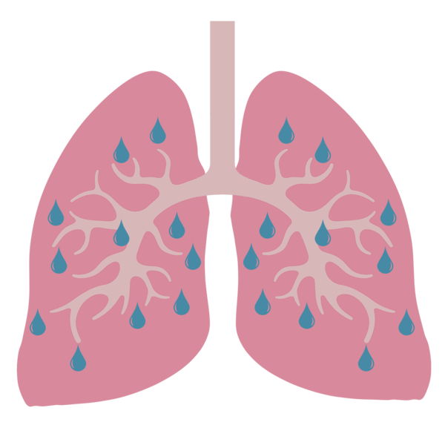
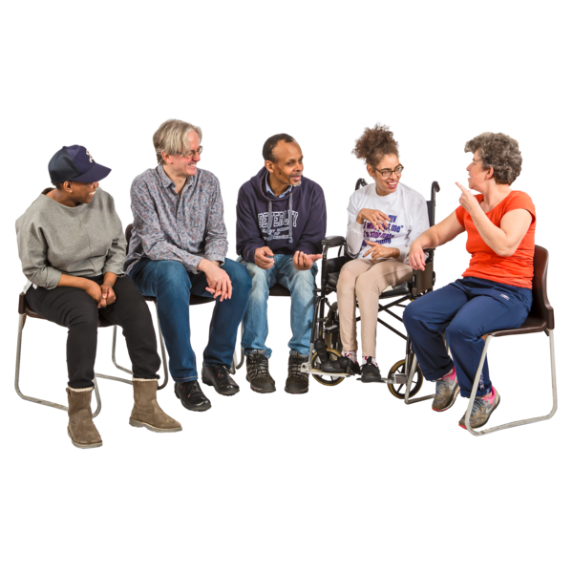
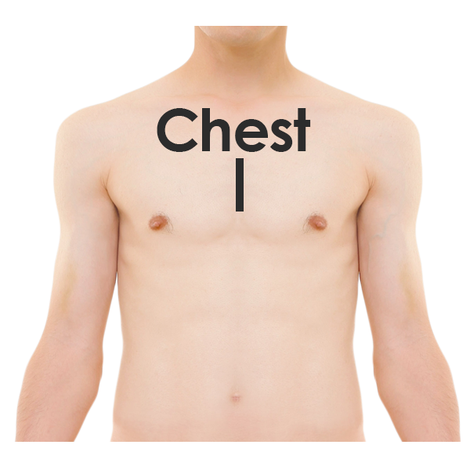
About people who died – Thomas
At hospital Thomas was found to have a Pneumonia.
Decisions about Thomas’ medical care were made in his best interests.
Thomas had end of life care and his family were with him when he died.
Healthcare workers were worried his chest infections could have been found earlier.

Slide 14
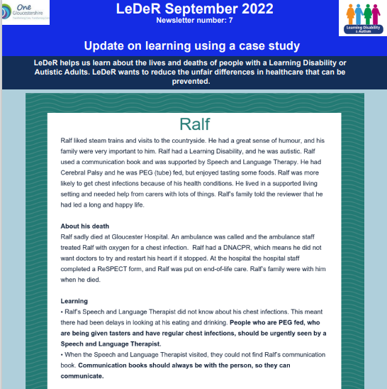
How we share the learning
Annual reports
Gloucestershire LeDeR Newsletter
Easy Read information
Learning on a page QA panel checklists
Information on the Gloucestershire LeDeR Webpage: https://www.inclusiongloucestershire.co.uk/engagement/leder/

Slide 15
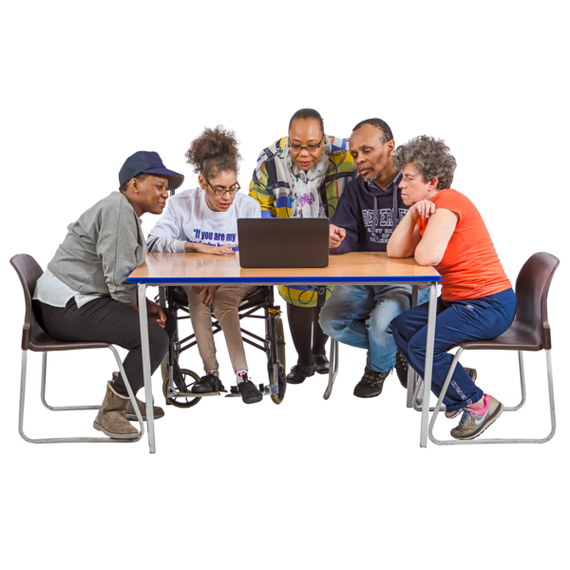
We have also shared learning at these events
The Big Health Day 2023.
Our LeDeR Conference in March 2023.
The Learning Disabilities Champions Conference in July 2023.
The Provider Forum in July 2023.
Our Health Action Group presentations.

Slide 16
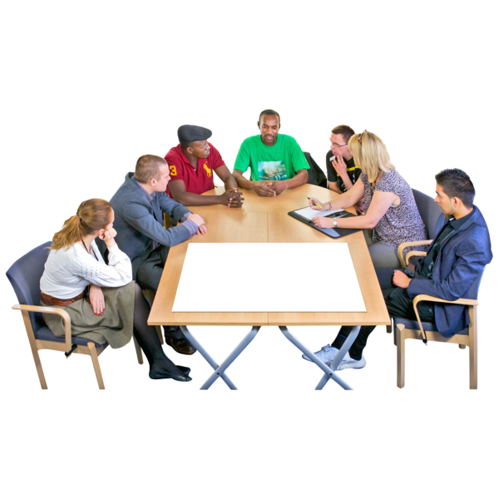
Other good things LeDeR has done
The LeDeR conference.
More people now check the reviewers have done a good job.
The full annual report is easier to read
People can watch films to find out about ReSPECT and RESTORE 2.

Slide 17
A film helping explain ReSPECT Jenny’s Story

Slide 18
A film helping explain ReSPECT John’s Story

Slide 19
A film helping explain RESTORE 2 A Health toolkit

Slide 20
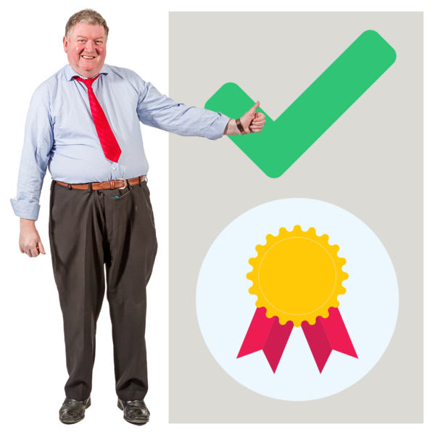
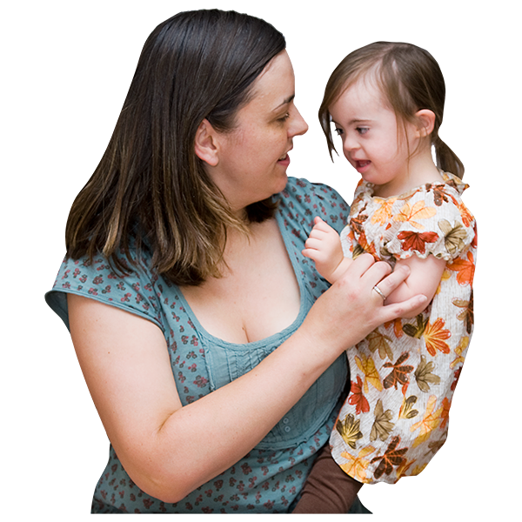
How many people died.
LeDeR was told about 48 people with a Learning Disability who died during the year.
26 people have had their LeDeR reviews completed.
15 reviews have been done but are waiting to be quality checked.
6 reviews are waiting to be done.
1 review is waiting for a child death review.
Notes:
25 people had a ReSPECT form.

Slide 21
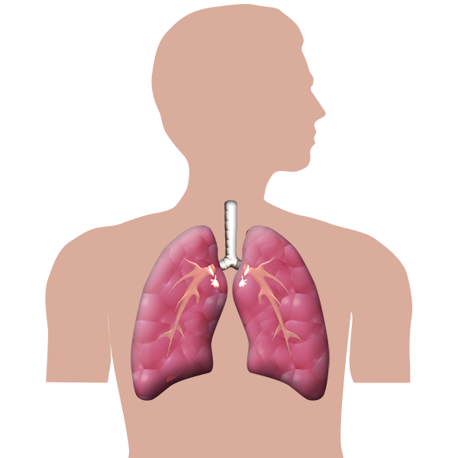
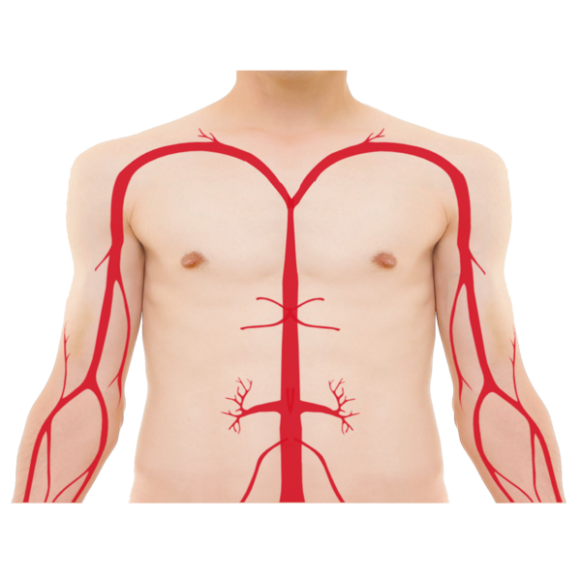
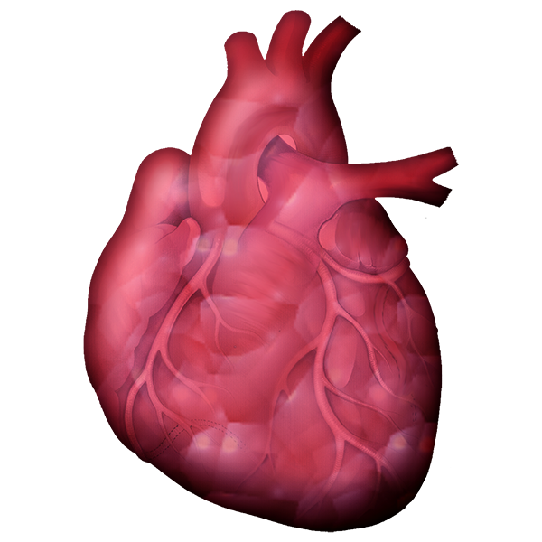
Top 4 causes of death
Breathing and Lung issues (Respiratory), including COVID 19.
2. Stomach issues
3. Problems with the Heart and Blood
4. Cancers

Slide 22
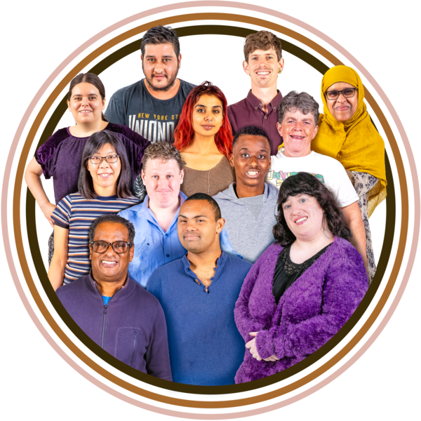
Gender
26 people who died were female.
22 people were male.
3 people were from an ethnic minority
Minority ethnic groups means people from different countries and cultures.

Slide 23
Quality of Care.
7 people had excellent care.
11 people had good care.
5 people had care that was good enough.
1 person had care that was not as good as it should have been.

Slide 24
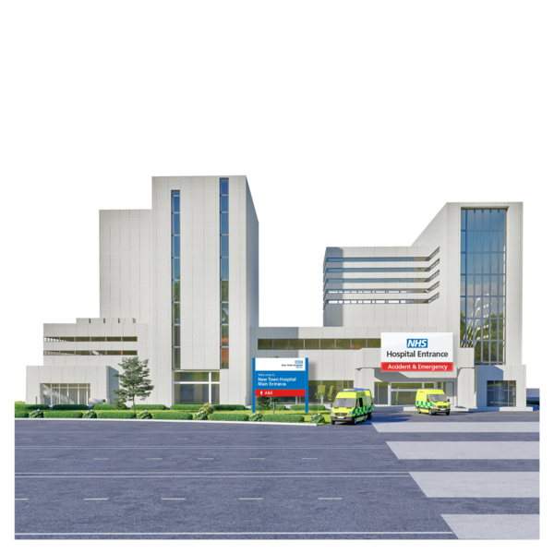
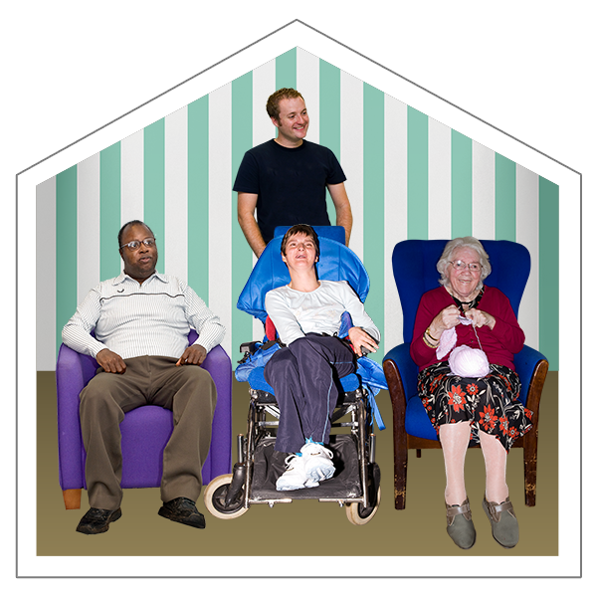
Where people died
25 people died at Gloucester Hospital.
8 people died where they normally lived.
9 people died in a care home.

Slide 25
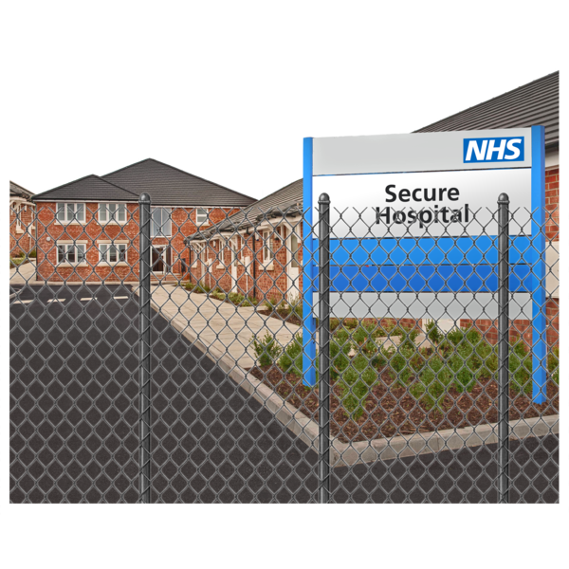
Who told us about the deaths…
Gloucestershire’s hospitals told LeDeR about 18 people who died during the year.
Gloucestershire Health and Care also told LeDeR about 18 people who died during the year.
Gloucestershire Health and Care are part of the NHS and run services like the Community Learning Disabilities Team.

Slide 26
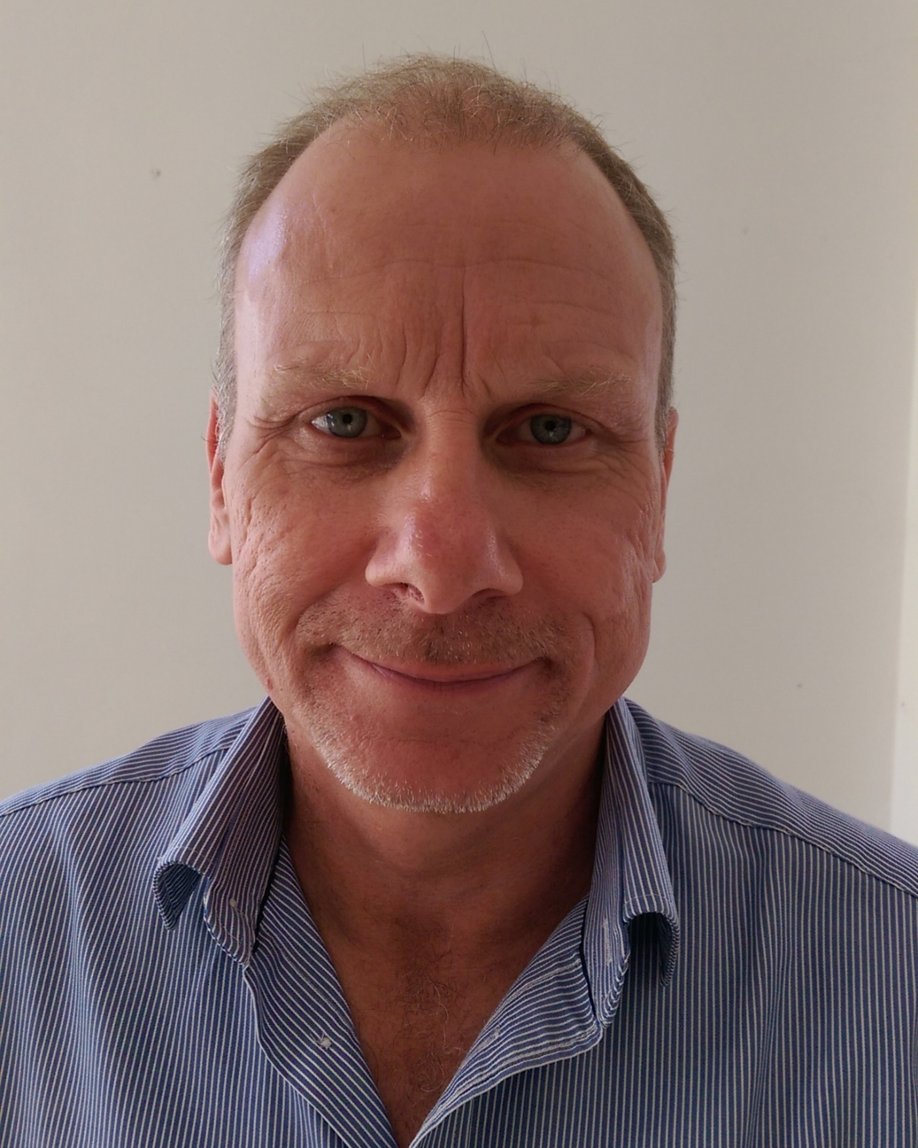
Words from our reviewer Paul
I have seen good changes in health and social care since joining the LeDeR team.
Care providers are happy to be involved in LeDeR.
More work is needed to have the same good standards across the county.
This is to make sure that more people can lead their best life.

Slide 27
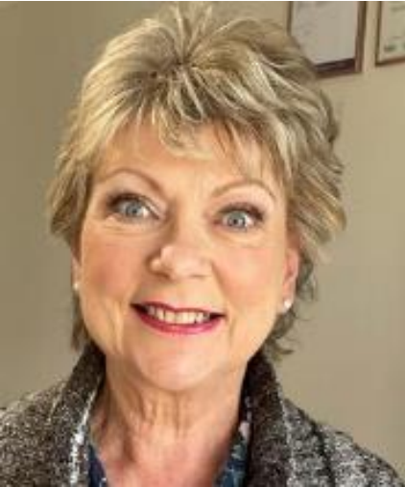
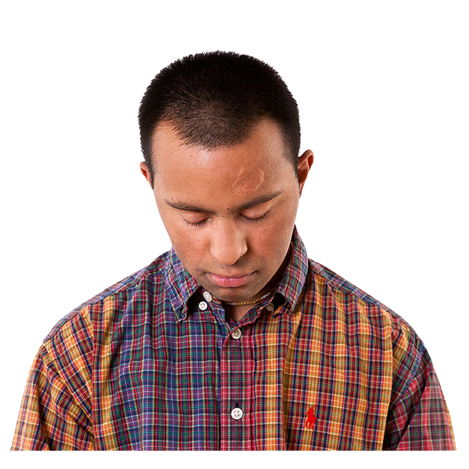
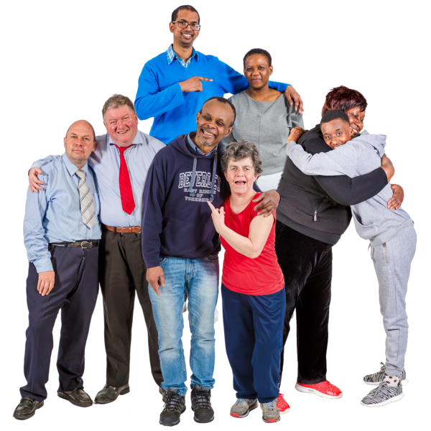
Words from our reviewer Deborah
It is great to work with lots of different people to make local services better.
Doing reviews can be upsetting.
But it makes me happy when things are done differently to make care better.
My favourite part of LeDeR is talking with family and friends who knew the person well.

