Slide 1

LeDeR in Gloucestershire

Slide 2
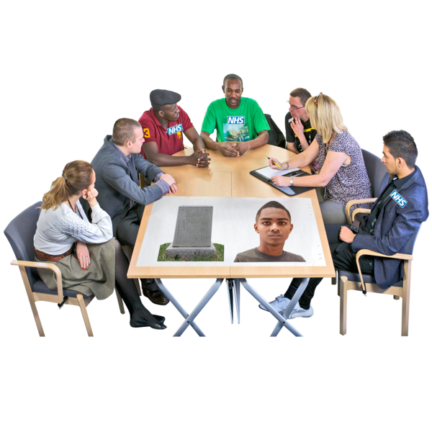

What is LeDeR?
LeDeR is learning about peoples lives and deaths so that we can make healthcare better.
LeDeR tells us the main reasons why people die too soon.

Slide 3

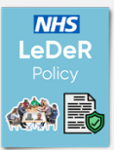
What is LeDeR?
We talk about both people with a Learning Disability from aged 4, and Autistic people aged over 18.

Slide 4





LeDeR Programme Aims
Improve health and social care for people with a learning disability and autistic people.
Reduce health inequalities for people with a learning disability and autistic people.
Health inequalities are unfair and preventable differences in health.
Stop more people from dying too soon by making care better.

Slide 5

LeDeR in Gloucestershire
  A reviewer works to find out what happened during someone's life and death.
  They will talk to someone who knows the person well, including family, carers and the doctor.
  3. The review gets checked by the Quality Assurance panel, which includes: doctors, pharmacists, nurses and experts by experience. Focused reviews are completed for anyone who is an autistic person or from a minority ethnic background. A focused review is a more in-depth review.
  4. We learn from each review and share the learning

Slide 6
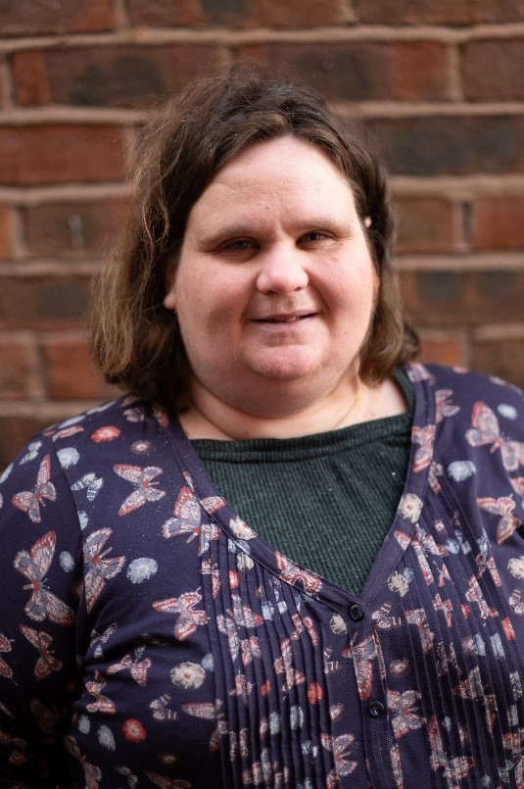
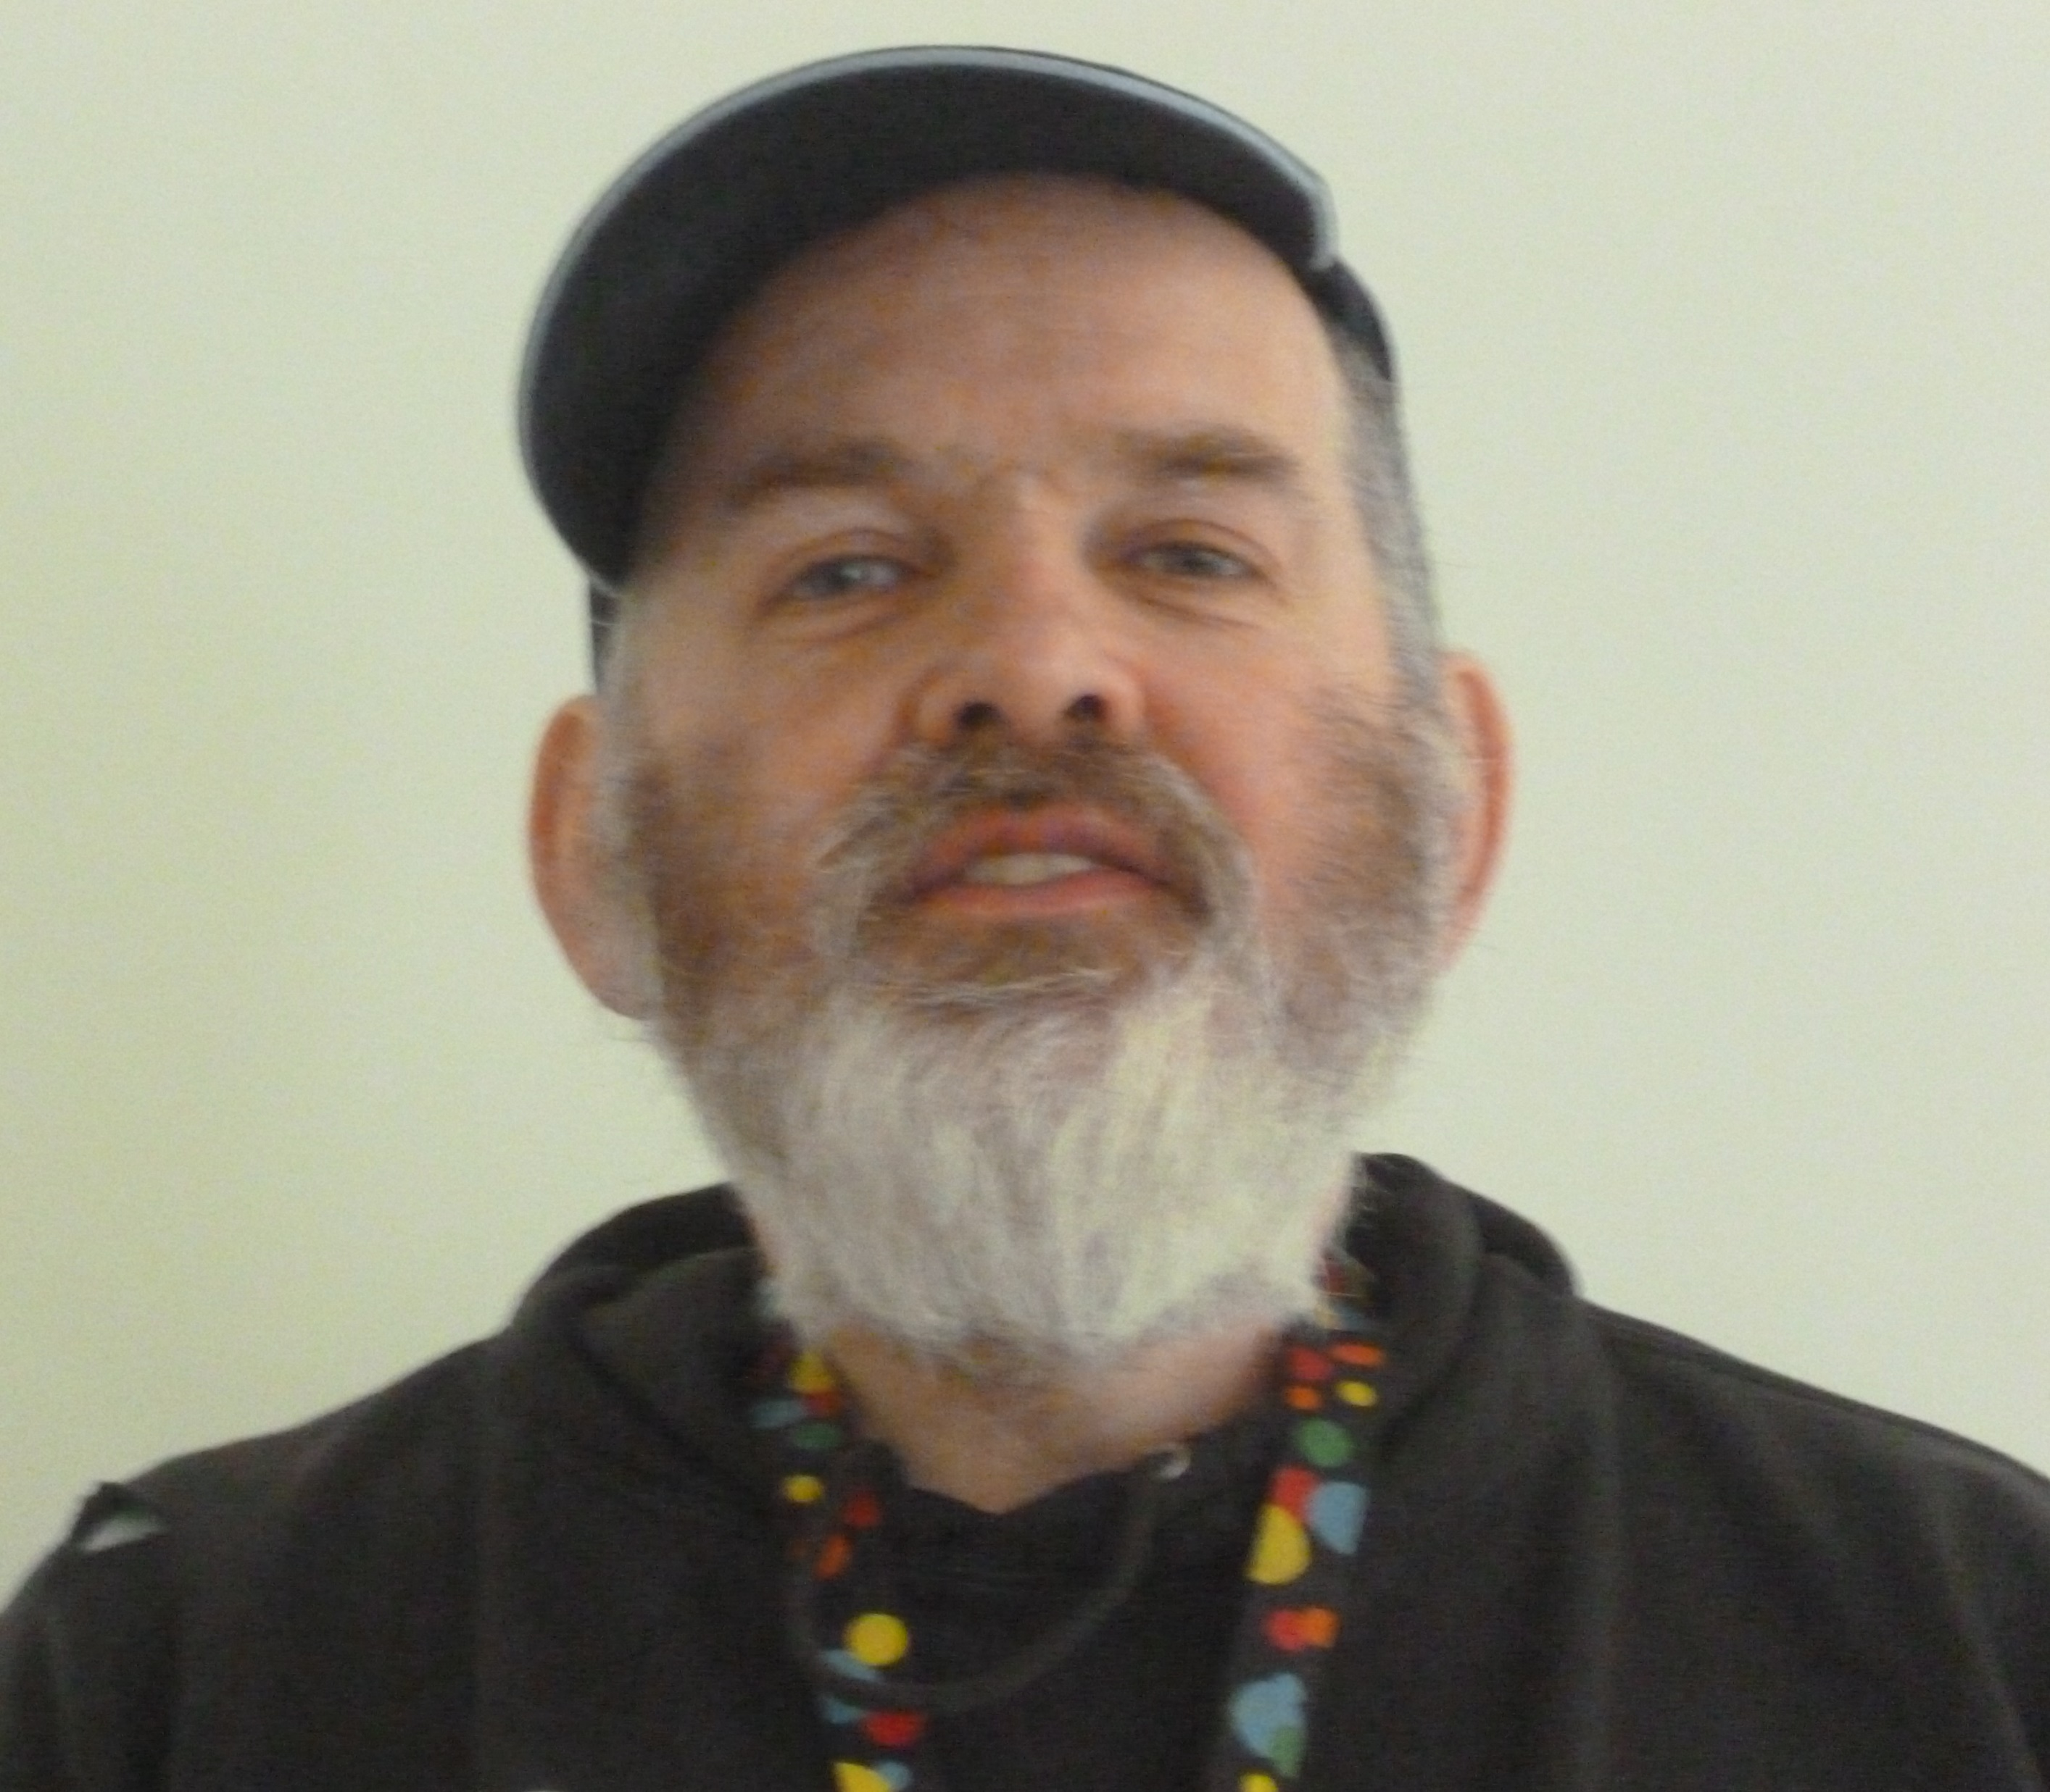
Importance of Experts by experience in LeDeR
In Gloucestershire Sammy and Nick are part of the Quality Checking Panel to make sure that the voices of people with Learning Disabilities and Autism are heard.
Experts by Experience are involved in everything to do with LeDeR:
Steering Group
Learning into Action
Development of resources
Raising awareness of the programme

Slide 7
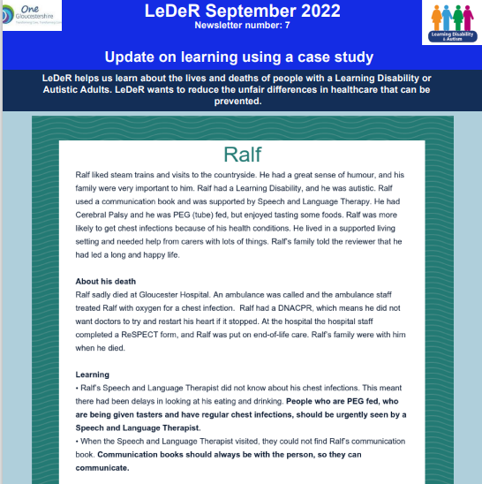
How we share the learning
Annual reports
Gloucestershire LeDeR Newsletter
Easy read resources
Learning on a page QA panel checklists
Access information on the Gloucestershire LeDeR Webpage: https://www.inclusiongloucestershire.co.uk/engagement/leder/

Slide 8
Gloucestershire LeDeR Newsletter
In Gloucestershire we have a newsletter to tell people what we have found out and what actions we have taken to make things better.
We share the newsletter every other month.
It includes the story of someone who has sadly died.

Slide 9


We share the learning at different events
The Big Health Day
Our LeDeR Conference (March 2023)
The Learning Disabilities Champions Conference (July 2023)
The Provider Forum (July 2023)
Health Action Group Presentations

Slide 10
Reporting a Death
Anyone can report a death to LeDeR through this website:
https://leder.nhs.uk/

Slide 11
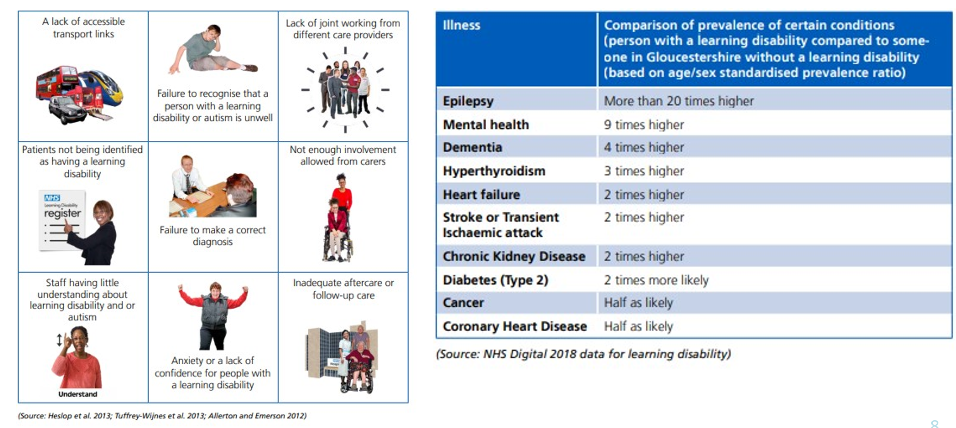
Health Inequalities faced by autistic people and people with a learning disability

Slide 12
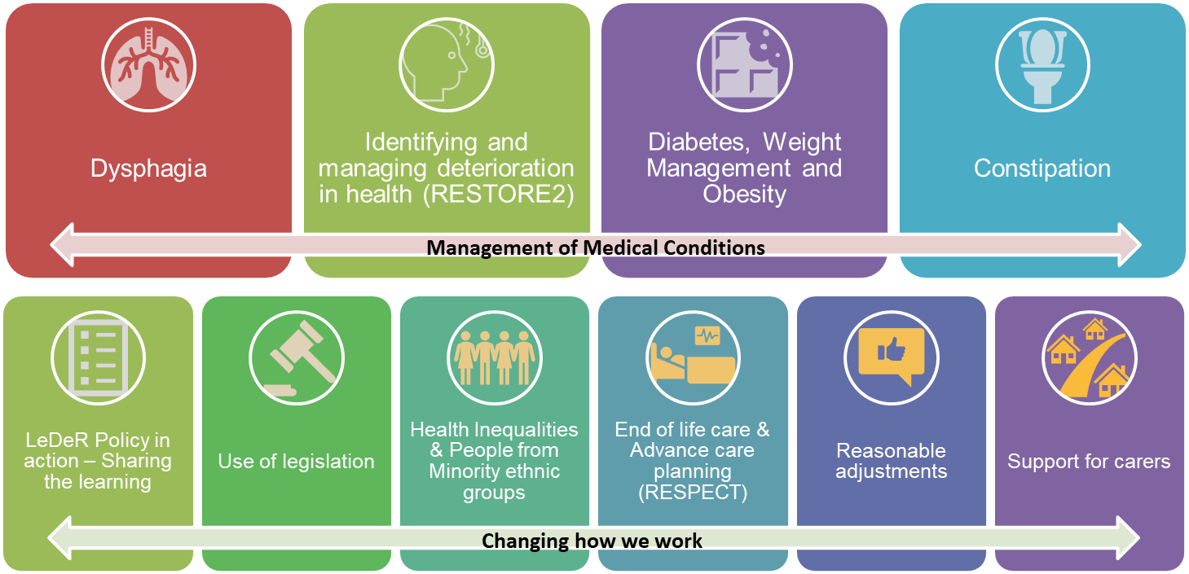
Action from Learning Summary

Slide 13

Identifying and managing deterioration in health- RESTORE2 Mini
RESTORE2 mini is a health toolkit that can be used by parents, carers and support staff to help monitor a person’s soft signs. It helps them to know when someone is unwell and when they need to seek medical assistance.
We have made a film to show how RESTORE 2 mini can help: https://bit.ly/3ID6Kka

Slide 14
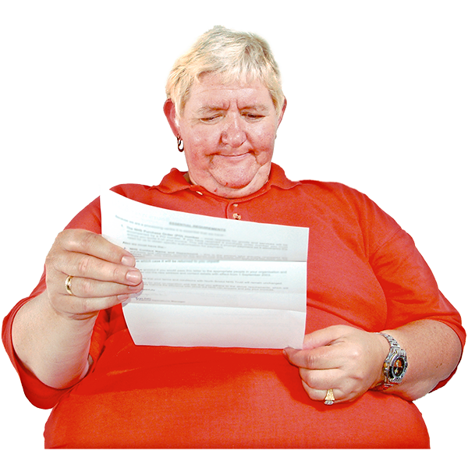

Health Screenings.
It is important to go to your Health Screening appointments. You might get a letter through the post, or your GP may contact you.
Health screenings are offered by the NHS to see if people are showing signs of certain health problems, such as bowel cancer.
Screening can help get earlier treatment.

Slide 15
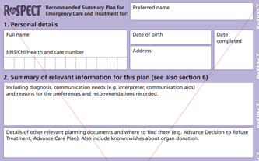
What do people want if they have to go into hospital - Advanced Care Planning using the ReSPECT form.
ReSPECT stands for Recommended Summary Plan for Emergency Care and Treatment.
This form can include any reasonable adjustment a person might need if they have to go into hospital. It also explains a persons end of life wishes.
They should be completed when a person is well.
RESPECT Easy read leaflet (link here)

Slide 16

ReSPECT resources
5 Easy Read guides: https://bit.ly/3w20751
Training resources for healthcare staff: https://bit.ly/3sUu03O
Myth buster: https://bit.ly/3ITeXhz
Top tips guide: https://bit.ly/3tFtEye

Slide 17
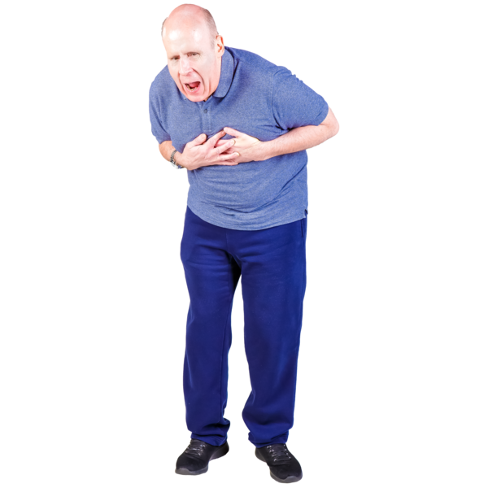
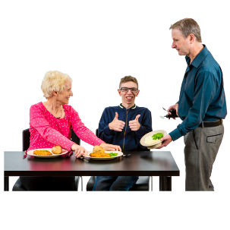
Dysphagia
People who have trouble swallowing and get lots of chest infections should have a dysphagia assessment.
Where someone has SLT eating and drinking guidelines, these should always be followed when the person goes into hospital.
SLT stands for Speech and Language therapy. SLT helps people with their eating, drinking and swallowing.

Slide 18

Knowing about the link between Dementia and Down’s Syndrome
People with Down’s Syndrome are more likely to develop a Dementia.
In Gloucestershire there is an early diagnosis assessment pathway available to people with Down’s Syndrome.
Information leaflet about the Memory Assessment Pathway (MAP) by NHS Gloucestershire Health and Care Foundation Trust: https://bit.ly/3Fmly1k
The MAP is available to people with Down’s syndrome from the age of 30

Slide 19
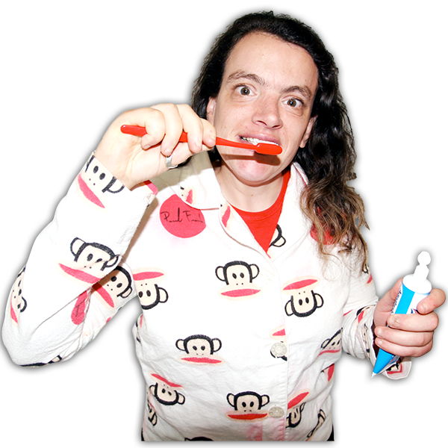
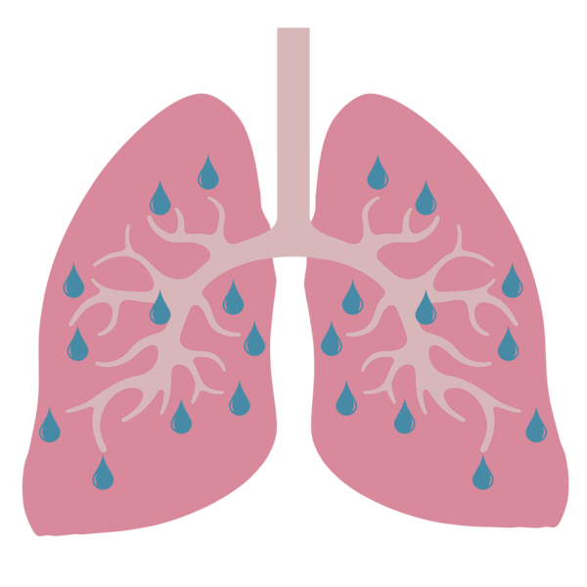
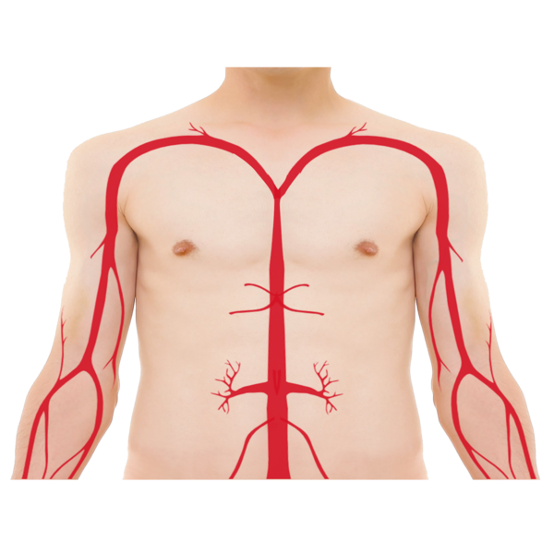
Keeping your mouth Clean
Keeping your mouth clean can help stop infections such as sepsis or aspiration pneumonia.
Aspiration pneumonia is a type of infection that happens when someone breathes something into their lung instead of swallowing it.
Sepsis is an infection in the blood

Slide 20
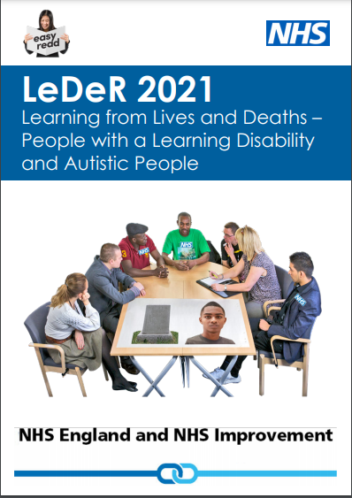
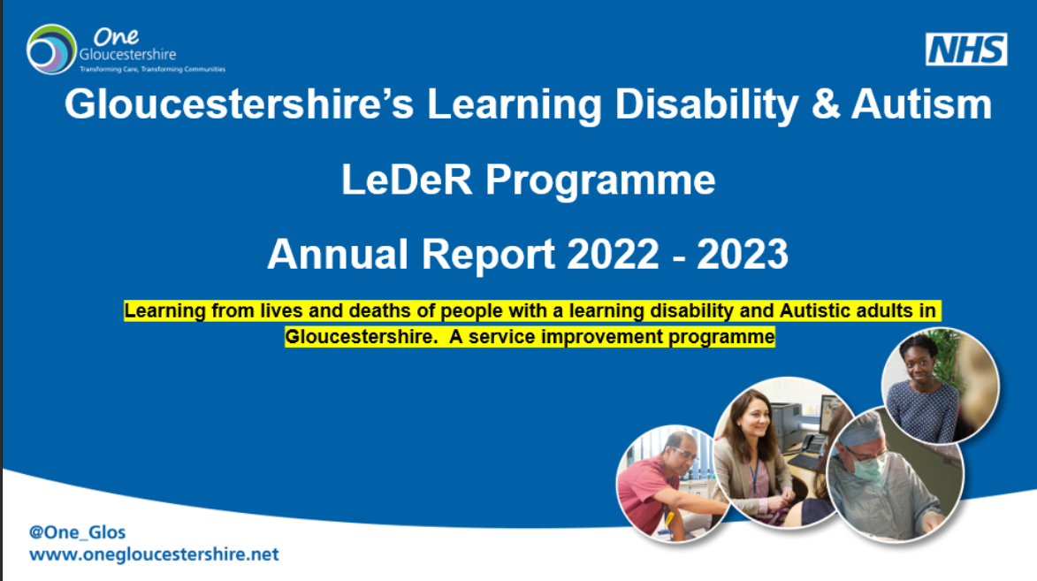
Want to find out more about LeDeR?
To read the National LeDeR policy, visit: https://bit.ly/3ITxXgk
To read our latest annual report, visit:
https://www.inclusiongloucestershire.co.uk/engagement/leder/

